Slide 1
What’s the Use of It?
How Are Earthquake Magnitudes Measured?

Slide 2
Table of Contents
Objectives
Competences
Charles Richter
The Richter Scale
Example 1
Example 2
Example 3
Example 4
Example 5
Tasks
11. Bibliography/Sources

Slide 3
Objectives
Develop a positive attitude towards learning Mathematics.
Perform mathematical operations with confidence, speed and accuracy.
Think and reason precisely, logically and critically in given situations.

Slide 4
Competences
Thinking mathematically:
a) understanding and handling the scope of a given concept
b) distinguishing between different kinds of mathematical
statements
2. Posing and solving:
a) identifying, posing and specifying different kinds of
mathematical problems.
b) solving different kinds of mathematical problems.

Slide 5
Charles Richter
Charles F. Richter
(1900. – 1984.)
American seismologist and physicist.
Richter is most famous as the creator of the Richter magnitude scale which, quantified the size of earthquakes.
The Richter scale was defined in 1935.

Slide 6
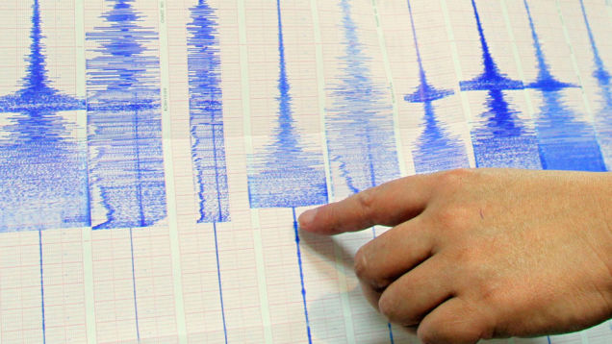
The Richter Scale
There are a number of ways to measure the magnitude of an earthquake. The first widely-used method, the Richter scale, was developed by Charles F. Richter in 1935.
It used a formula based on amplitude of the largest wave recorded on a specific type of seismometer and the distance
between the earthquake and the seismometer.

Slide 7
The Richter Scale
Magnitudes are based on a logarithmic scale (base 10). What this means is that for each whole number you go up on the magnitude scale, the amplitude of the ground motion recorded by a seismograph goes up ten times.
Magnitude scales can be used to describe earthquakes so small that they are expressed in negative numbers. The scale also has no upper limit, so it can describe earthquakes of unimaginable and (so far) inexperienced intensity, such as magnitude 10.0 and beyond.

Slide 8
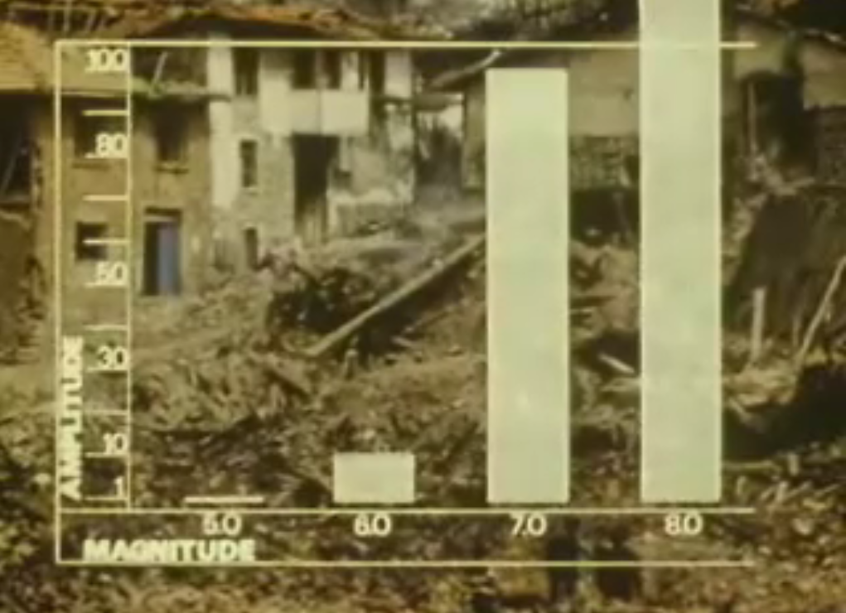
The Richter Scale
Here's a table describing the magnitudes of earthquakes, their
effects, and the estimated number of those earthquakes that
occur each year.
When an earthquake is greater than 5 degrees on the Richter scale, it will be reported worldwide, whereas less than 5 degrees earthquakes are used nationally for monitoring

Slide 9
The Richter Scale

Slide 10
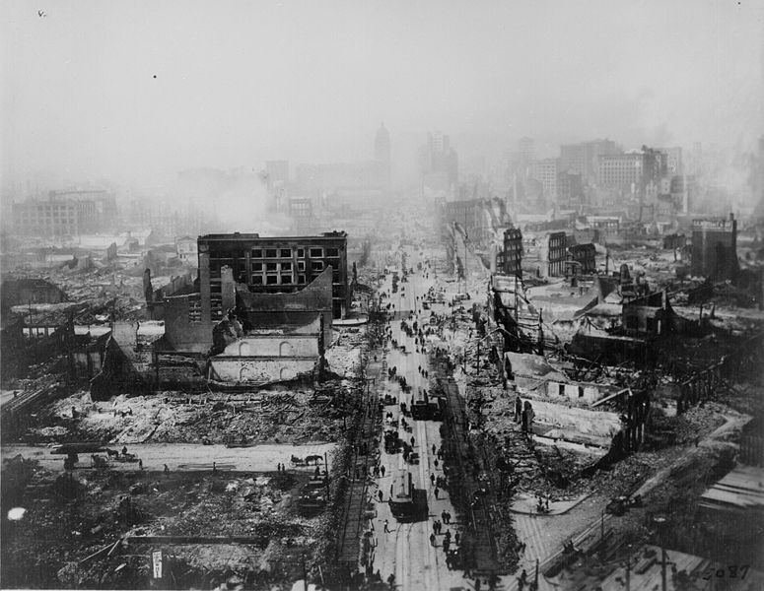
The Richter Scale
The magnitude M of an earthquake is measured by using the Richter Scale
E- energy released by an earthquake
E₀ – small reference energy earthquake, E₀=${10}^{4.4}J$

Slide 11
Example 1
In 1906, San Francisco was struck by an earthquake which released energy of approximately 5,96 x 10¹⁶J.
What was its magnitute on the Richter scale?
Solution:

Slide 12
Example 2
a) What is an earthquake magnitude on the Richter scale for which
E = 100000E₀ ?
_{Solution:}

Slide 13
Example 2
b) The 1906 earthquake in Colombia released energy
E = 398107000E₀. Determine the magnitude of the
earthquake on the Richter scale?
Solution:

Slide 14
Example 3
In 1992 an earthquake in Landers (USA) had 7.3 on the Richter scale and the 2003 earthquake in Bam (Iran) 6.7.
a) How many times the earthquake in Landers was stronger than the earthquake in Bam?
Solution:

Slide 15
Example 3
b) Compare the earthquake of 4.8 on the Richter scale with that in Bam. How many times was this earthquake less?
Solution:

Slide 16
Example 4
How many times was the earthquake in Gujarat in India in 2001 (7.9 degrees on the Richter scale) stronger than the earthquake in Athens, Greece in 1999 (5.9 degrees)?
Solution:
$$\begin{matrix}x=\frac{E_{1}}{E_{2}} \\ x=\frac{1.76⋅{10}^{16}}{1.76⋅{10}^{13}} \\ x=1000\end{matrix}$$

Slide 17
Example 5
If an earthquake is 1000 times stronger than any other earthquake, what is the difference of these earthquakes on the Richter scale?
Solution:
The difference on the Richter scale is 2.

Slide 18
Tasks
1.The 1906 earthquake in San Francisco had an estimated magnitude of 8.3 on the Richter scale. In the same year a powerful earthquake occurred on the Colombia-Ecuador border and was four times as intense. What was the magnitude of the Colombia-Ecuator earthquake?
2. The 1989 Loma Prieta earthquake that shook San Francisco had a magnitude of 7.1. How many times was the 1906 earthquake stronger than the1989 event?
3. How many times was the earthquake in Mexico in 1978 (7.9) stronger than the 1994 earthquake in LA (6.6) ?

Slide 19
Linear Scale, Logarithmic Scale
-2
-1
0
1
2
3
Sometimes certain data are graphically displayed so that they join the point line. The most commonly used is a linear scale.
But such a scale is sometimes impractical and apply some other scales, such as, for example, a logarithmic.
Linear scale can be converted into a logarithmic so that each number b of a linear scale the number is joined.
0.01
0.1
1
10
100
1000

Slide 20
Table
Magnitude | Earthquake Effects | Estimated Number Each Year
2.5 or less | Usually not felt, but can be recorded by seismograph. | 900,000
2.5 to 5.4 | Often felt, but only causes minor damage. | 30,000
5.5 to 6.0 | Slight damage to buildings and other structures. | 500
6.1 to 6.9 | May cause a lot of damage in very populated areas. | 100
7.0 to 7.9 | Major earthquake. Serious damage. | 20
8.0 or greater | Great earthquake. Can totally destroy communities near the epicenter. | One every 5 to 10 years

Slide 21
Bibliography/Sources
Books:
Stewart, James. Algebra and Trigonomerty. Belmont, USA: Thomson, Brooks/Cole, 2007. Second edition.
Web sites:
http://en.wikipedia.org/wiki/Richter_magnitude_scale
Web. April 2015.
http://earthquake.usgs.gov, Web. April 2015.
http://pnsn.org/outreach/about-earthquakes/magnitude-intensity, Web. April 2015.

